Slide 1
Analysis of Algorithms
Lecture 4

Slide 2
Recursive Functions

Slide 3
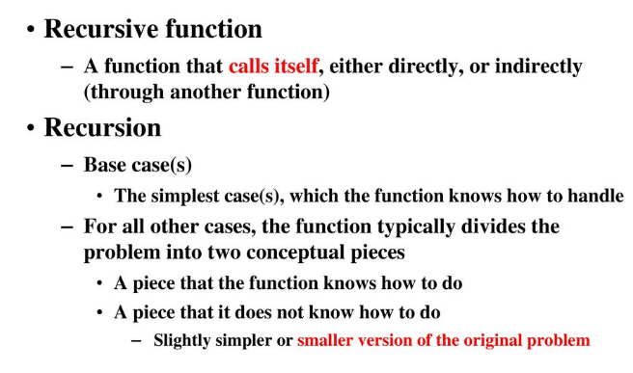
Recursion

Slide 4
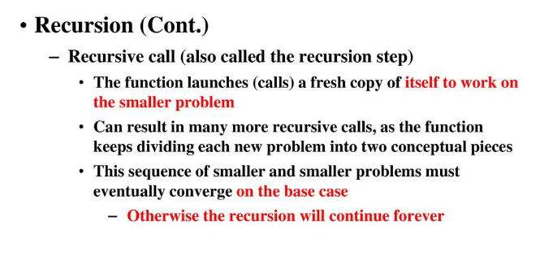
Recursion

Slide 5
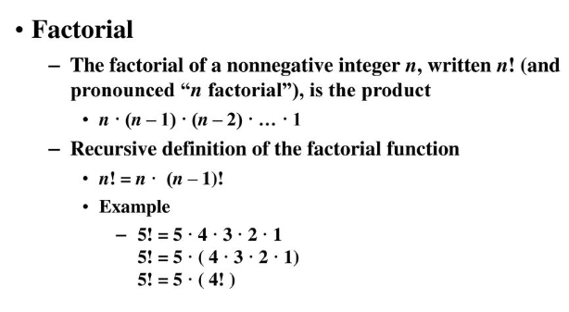
Recursion

Slide 6
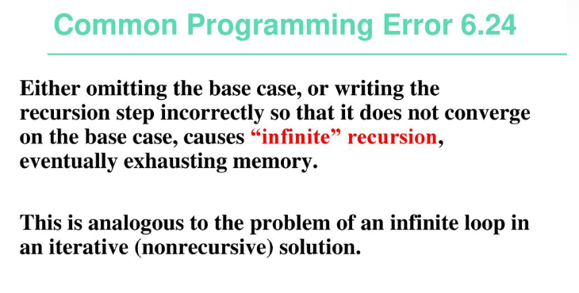

Slide 7
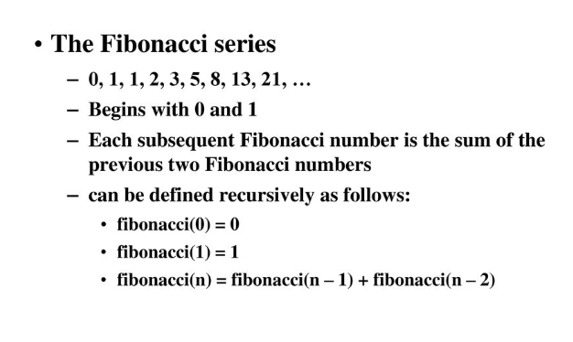
Example using Recursion

Slide 8
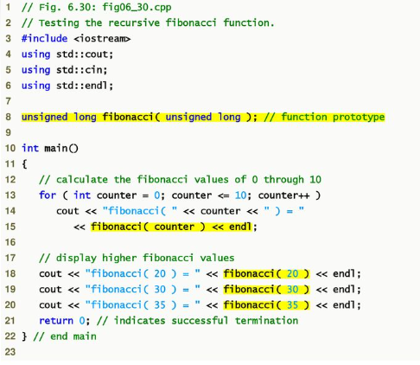

Slide 9
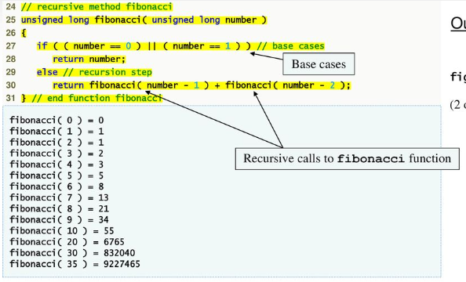

Slide 10
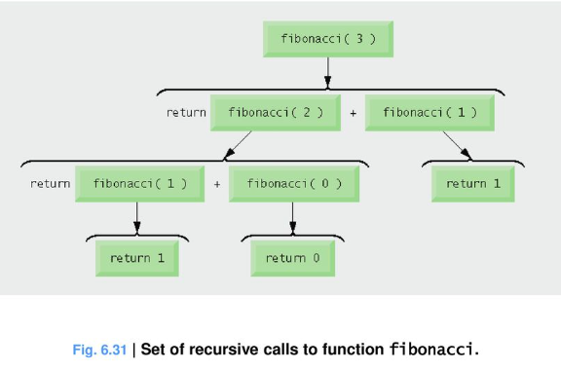

Slide 11
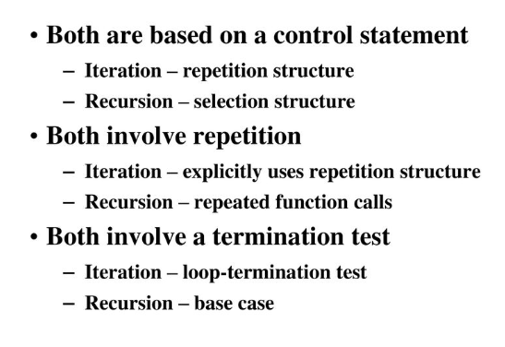
Recursion vs Iteration

Slide 12
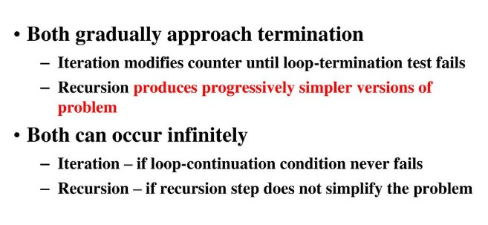
Recursion vs Iteration

Slide 13
Recursion and Recurrence Relations

Slide 14
Recurrences and Running Time
An equation or inequality that describes a function in terms of its value on smaller inputs.
T(n) = T(n-1) + n
Recurrences arise when an algorithm contains recursive calls to itself
What is the actual running time of the algorithm?
Need to solve the recurrence
Find an explicit formula of the expression
Bound the recurrence by an expression that involves n

Slide 15
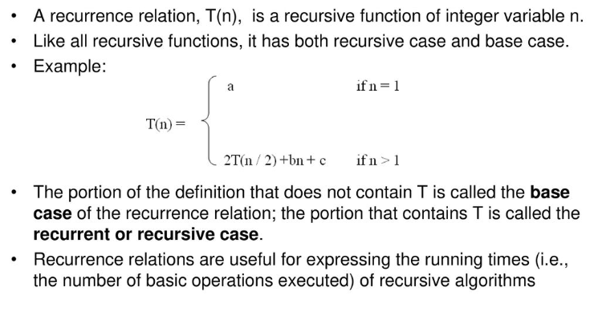
What is Recurrence Relation?

Slide 16
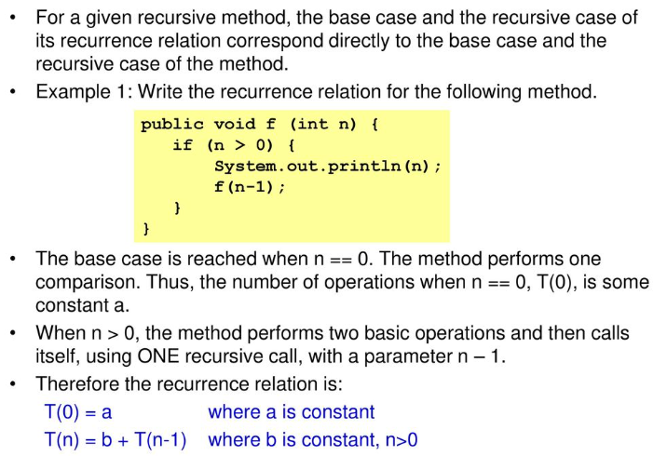
Forming Recurrence Relations

Slide 17
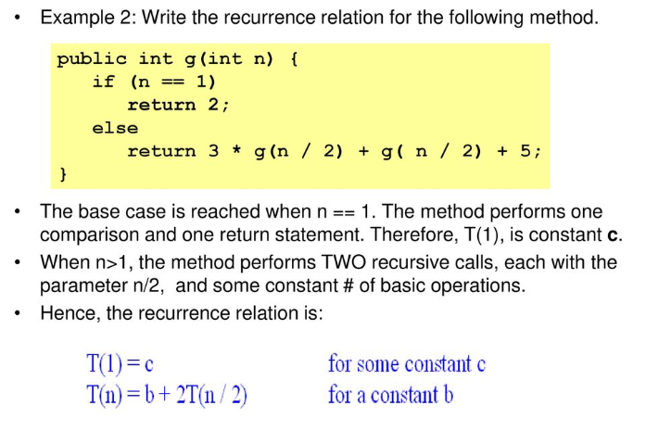
Forming Recurrence Relations

